Slide 1


MySQL Database for an Online Greeting Card Retailer: Project Overview
- Aimee Carter, Angharad James

Slide 2
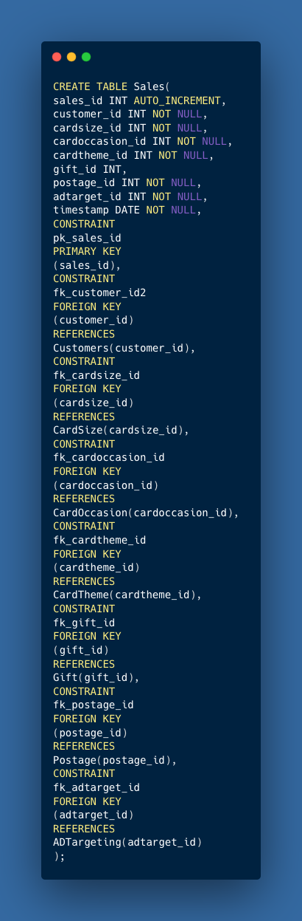
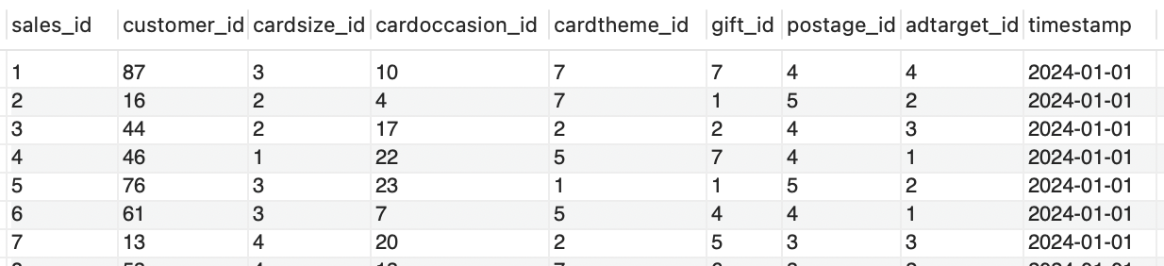
Database
Sales
Design
Tables
Standardised parent table consisting of 1000 orders from 1st January until the 30th June.

Slide 3
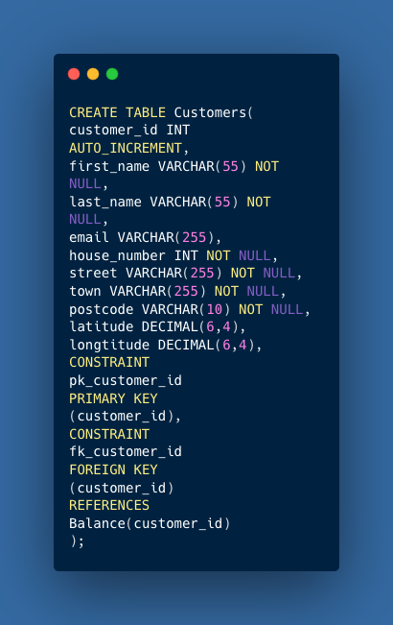
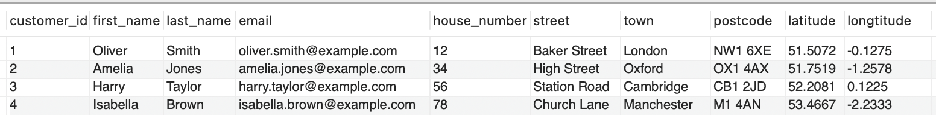
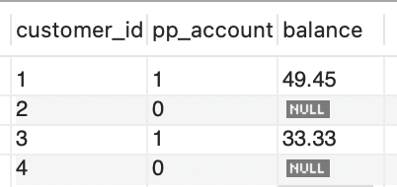
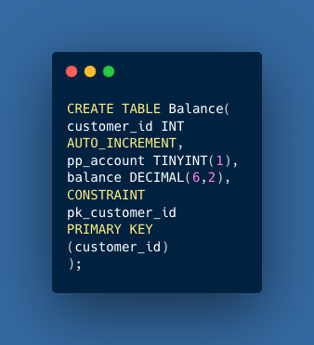
Database
Customer and Balance
Design
Tables
Balance is a child table with customers as its parent.
Customers can request a pre-payment account. This is set as 1 on pp_account and balance is recorded.

Slide 4
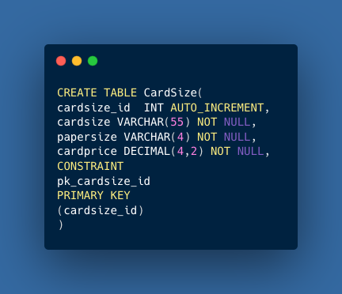
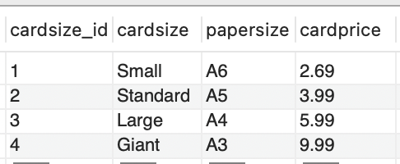
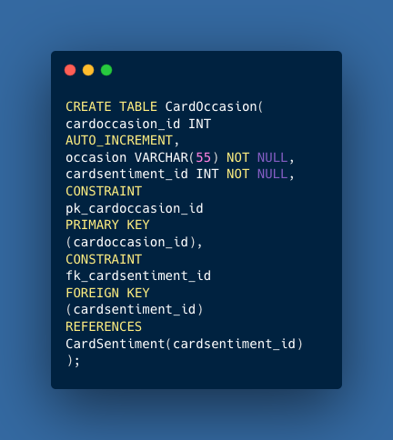
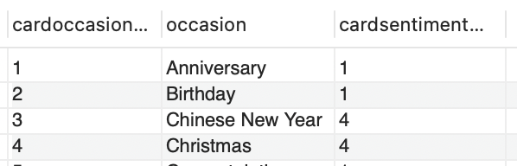
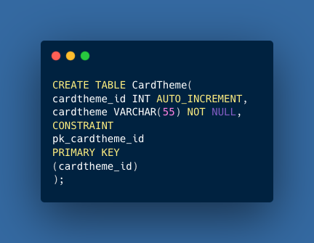
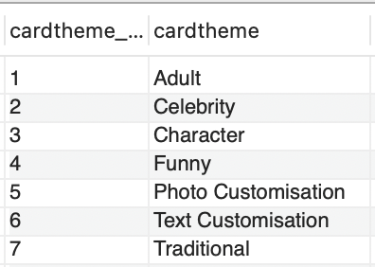
Database
Greeting Card Variations
Design
Customers can choose from different sizes, occasions and themes of greetings card.
4 Card Sizes
23 Card Occasions
7 Card Themes
Tables

Slide 5
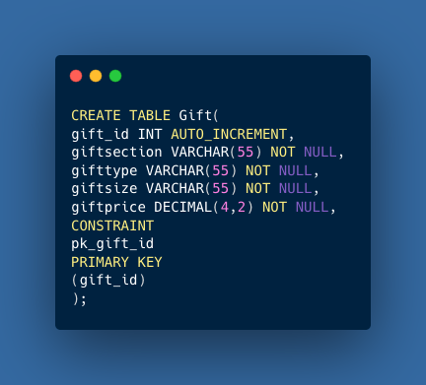
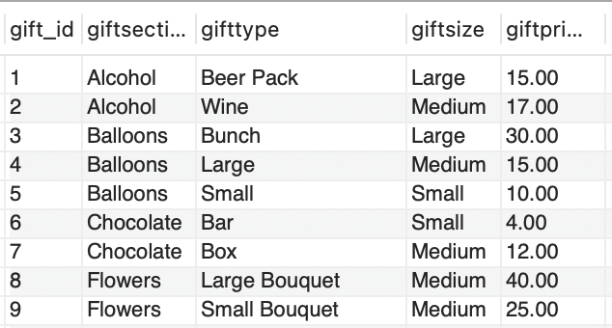

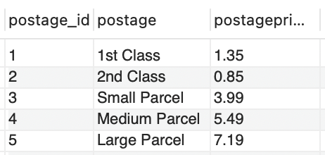
Database
Gifts and Postage
Design
Gifts are an optional sale. Postage is dependent on a gift purchase.
If no gift is purchased, customers can choose options 1 or 2. Other postage options are dependent of the size of the gift.
Tables

Slide 6
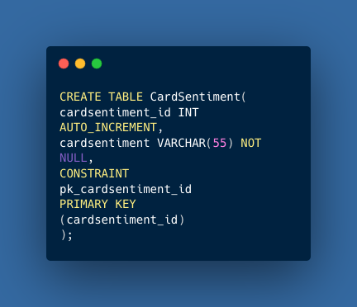
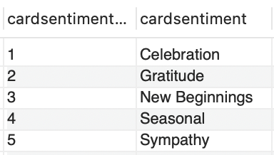
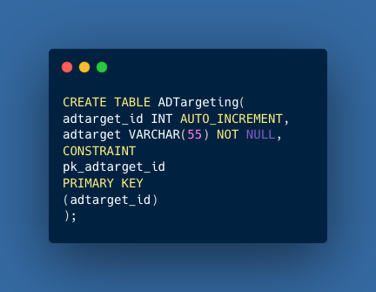
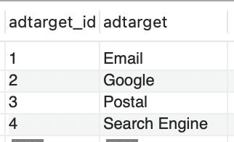
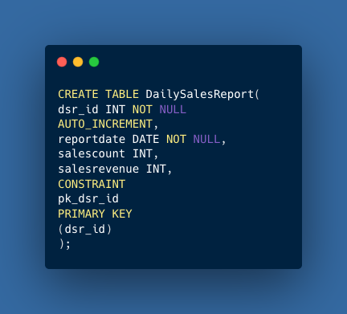
Database
Business Tables
Design
CardSentiment and ADTargeting are tables created for predictive analysis to enquire what are the best-selling ranges and methods of promotion to create a boost in sales.
DailySalesReport was generated for our daily sales event output.
Tables

Slide 7
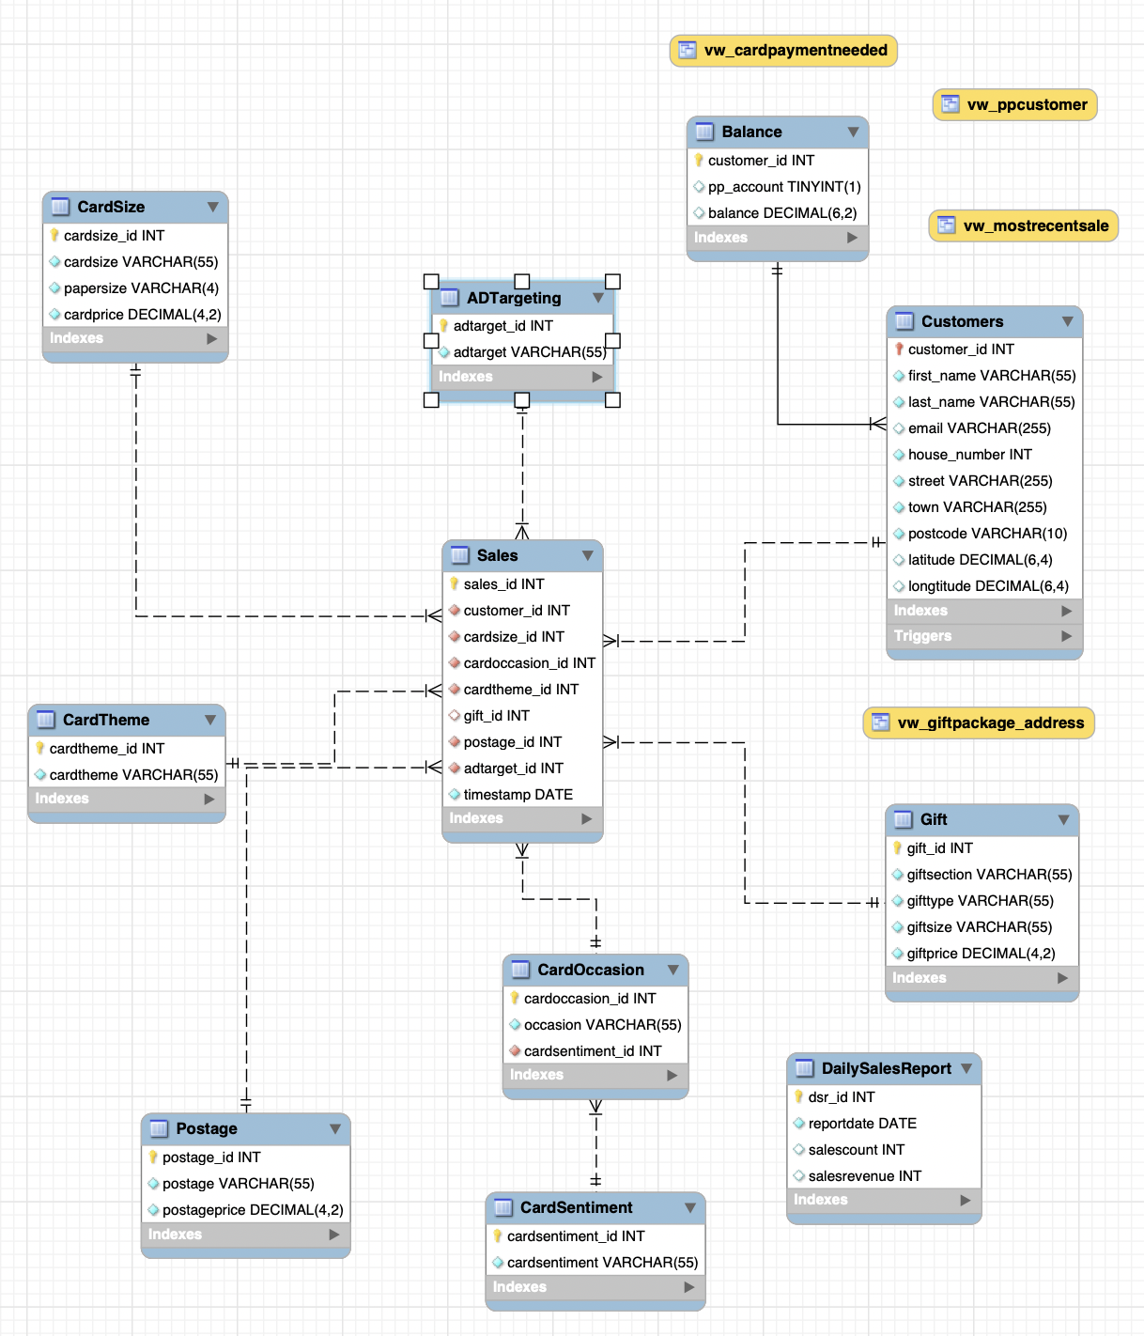
Database
Design
EER
Diagram

Slide 8
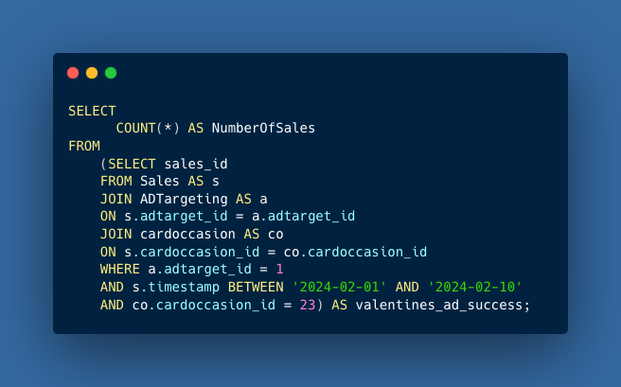
How successful was our Valentine’s Day email advert campaign?
This subquery identifies Valentine's Day card sales driven by email campaigns that took place between February 1st and February 10th.
Subquery

Slide 9
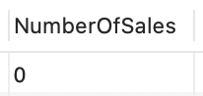
How successful was our Valentine’s Day email advert campaign?
Unfortunately, the results indicate that this ad campaign was completely unsuccessful.
Subquery

Slide 10
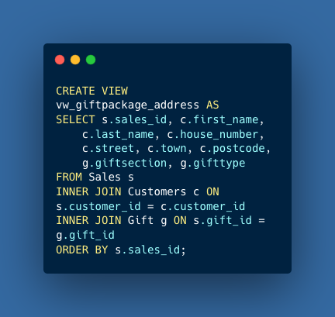
How can we speed up the gift packing process?
In this view creation, the packer can see the customer's address and gift order.
View

Slide 11
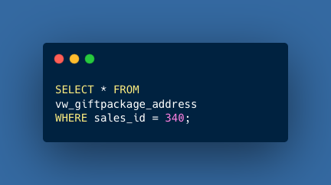
How can we speed up the gift packing process?
The packer can collect a bunch of balloons and match it to the sales ID, customer's name, and address. This process reduces the likelihood of orders being incorrect or missing.
View

Slide 12
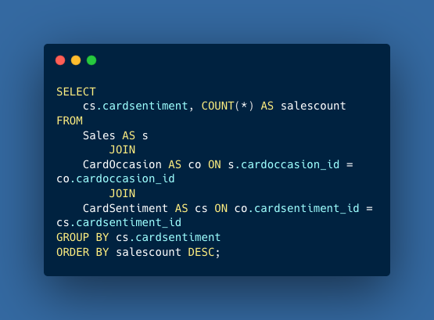
Which Sentiment Category Tops the Sales List, and What Occasion Is Behind Its Success?
Group By & Having
Querying the database to identify the sentiment category that generates the highest sales count.

Slide 13
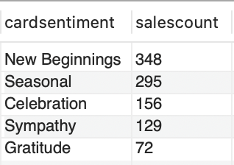
Which Sentiment Category Tops the Sales List, and What Occasion Is Behind Its Success?
Group By & Having
The sentiment category 'New Beginnings' (cardsentiment_id 3) has the highest sales count.

Slide 14
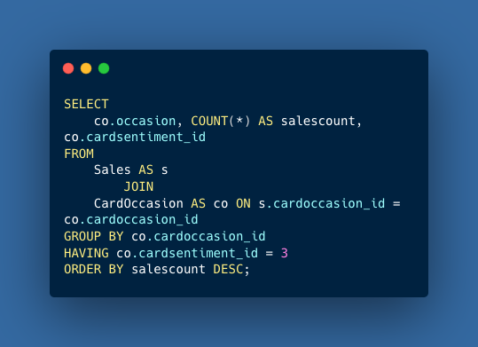
Which Sentiment Category Tops the Sales List, and What Occasion Is Behind Its Success?
Group By & Having
We can now use this analysis to further examine our occasion ranges to identify the most frequently sold greetings occasion.

Slide 15
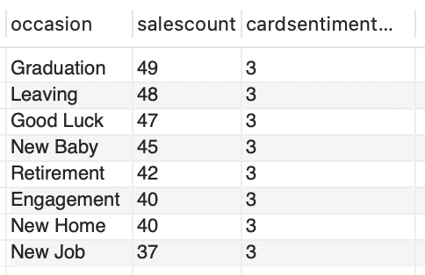
Which Sentiment Category Tops the Sales List, and What Occasion Is Behind Its Success?
Group By & Having
Graduation cards are the most frequently sold items within our 'New Beginnings' range.

Slide 16
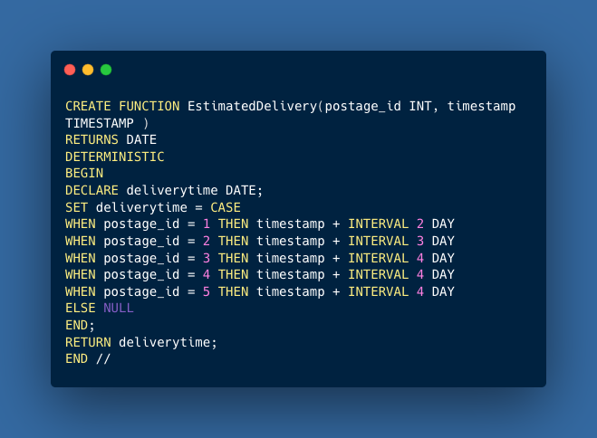
How Can We Refine Our Approach to Estimating Delivery Times?
Stored Function
This stored function estimates the delivery time for a customer's order.

Slide 17
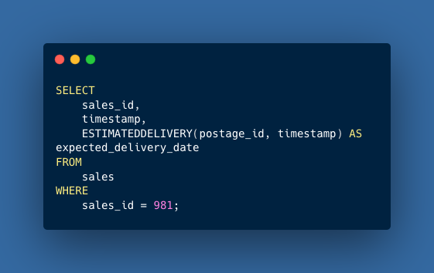
How Can We Refine Our Approach to Estimating Delivery Times?
Stored Function
A Customer with sales_id 981 has said their order has not arrived.

Slide 18
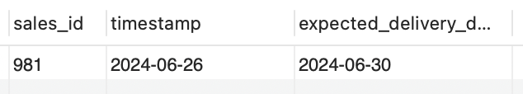
How Can We Refine Our Approach to Estimating Delivery Times?
Stored Function
Since the delivery date has significantly exceeded the expected time, we should issue a refund to the customer and initiate a claim with our delivery provider.

Slide 19
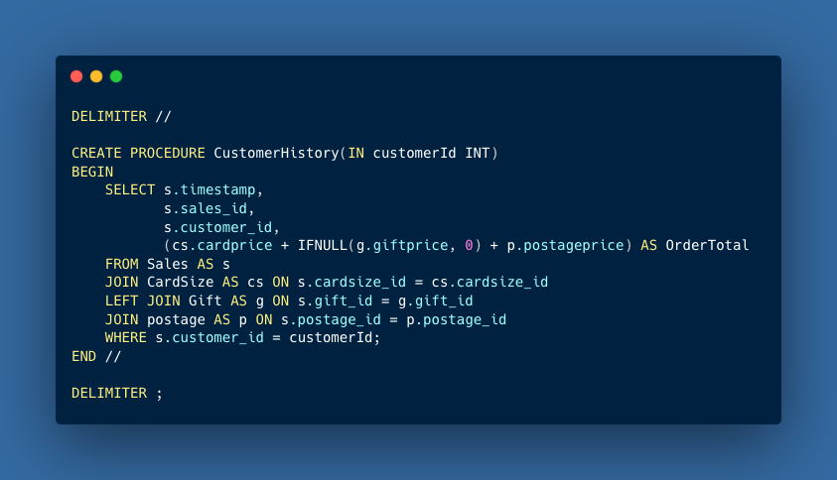
How Can We Efficiently Retrieve Customer Order History on Demand?
We can easilly generate a report on a customer's sales history using only their customer ID.
Stored Procedure

Slide 20
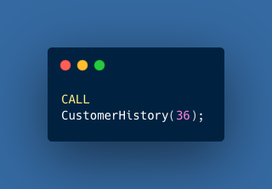
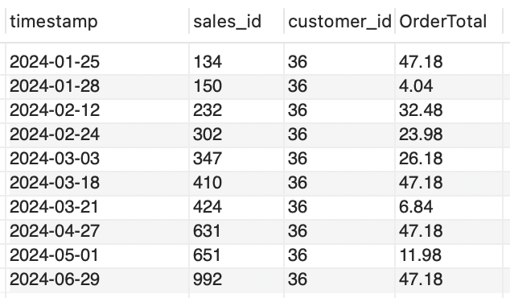
How Can We Efficiently Retrieve Customer Order History on Demand?
The order history for the customer with ID 36 can be retrieved using the CALL syntax.
Stored Procedure

Slide 21
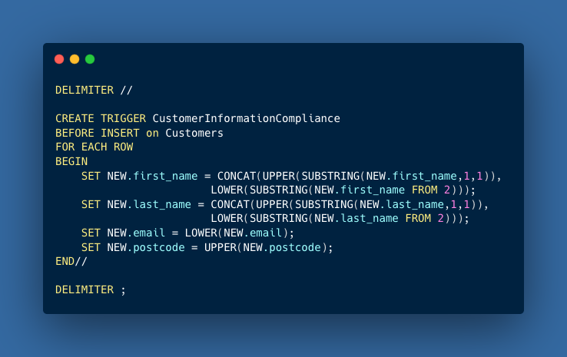
How Can We Standardize Customer Data Entry to Maintain Accuracy?
To ensure accuracy in our postage labels and customer emails, we should standardize the use of uppercase and lowercase letters in our data entry.
Trigger

Slide 22
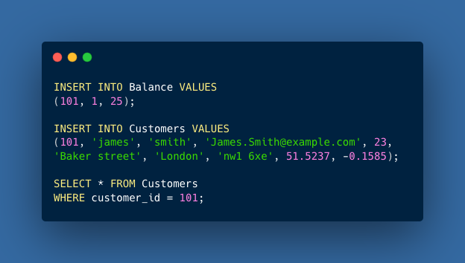
How Can We Standardize Customer Data Entry to Maintain Accuracy?
Reviewing the results, we can see that the trigger has standardized our data to align with the format used for other customers.
Trigger

Slide 23
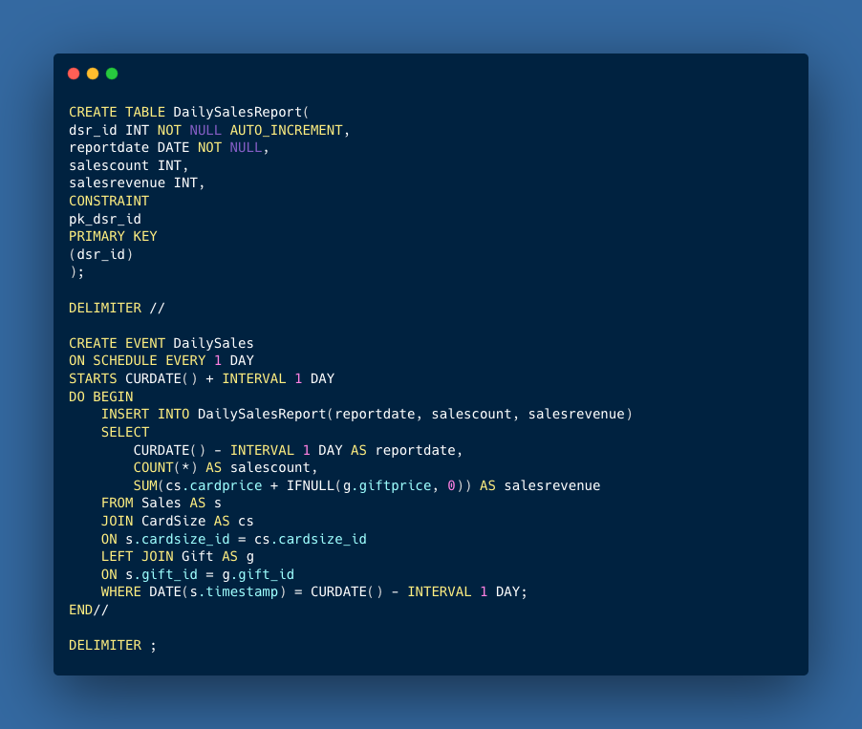
We created a new table for the daily sales report. With this scheduled event, the table will automatically update with the total revenue from the previous day.
What Tools Can Help Us Automate the Daily Sales Report Generation?
Event

Slide 24
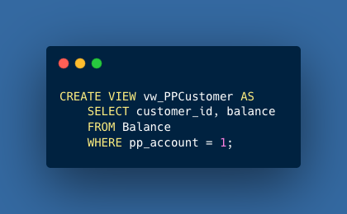
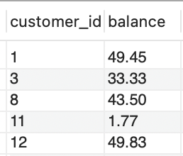
How Can We Calculate if a Pre-Payment Customer Needs to Top up Their Account?
We create a view just for pre-payment customers and their balances.
Nestled View

Slide 25
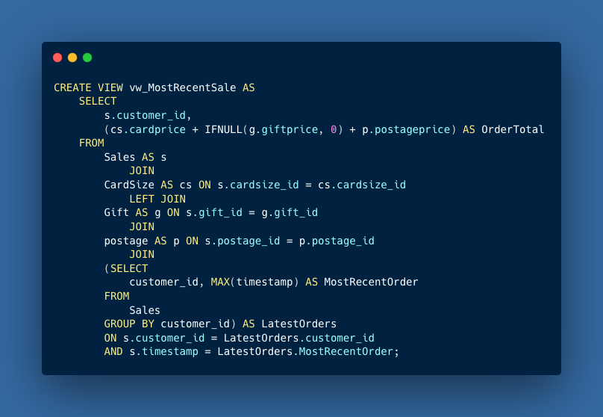
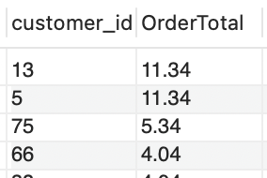
How Can We Calculate if a Prepayment Customer Needs to Top up Their Account?
A second view is created to find the most recent sales for all customers.
Nestled View

Slide 26
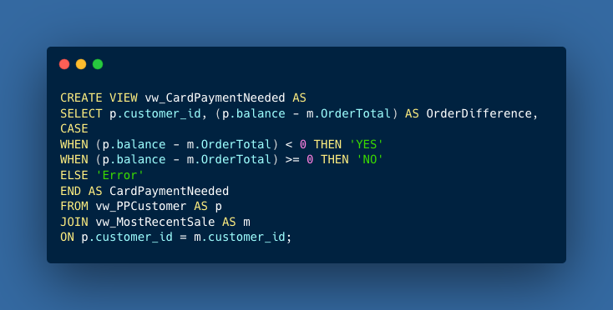
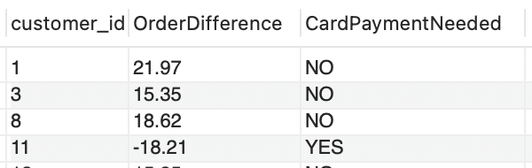
How Can We Calculate if a Prepayment Customer Needs to Top up Their Account?
Both views are joined together to create a third view where we can gather the difference between order total and prepayment balance.
Nestled View

Slide 27
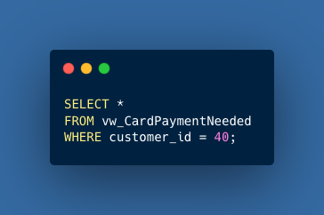
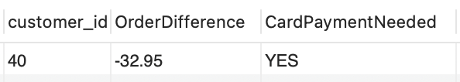
How Can We Calculate if a Prepayment Customer Needs to Top up Their Account?
If we look at our most recent prepayment customer who as id number 40. We see that they need to pay an additional £32.95 for their order.
Nestled View

Slide 28
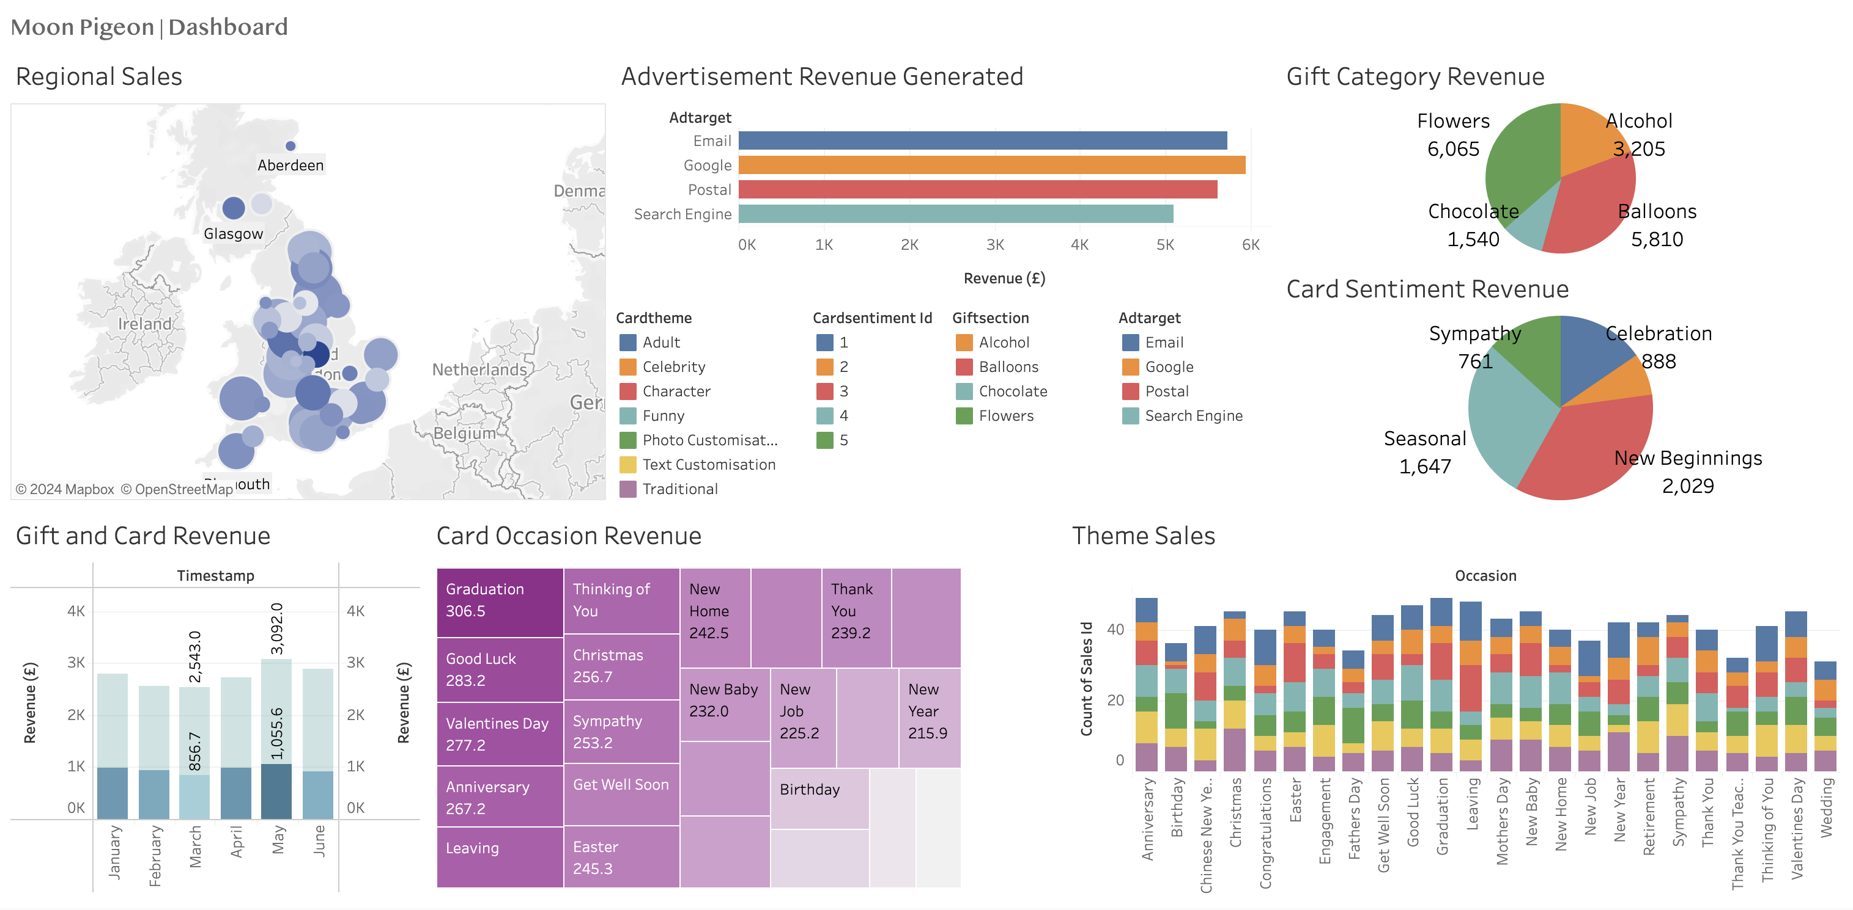
Tableau Sales Dashboard

Slide 29


Thank You

